Slide 1
Design – using OO patterns

Slide 2
Where are we..
Sprint 0: Prep
Sprint 1: Scoping
Sprint 2: Requirements
Sprint 3: High Level Design
Sprint 4: Scheduling & Testing / R1
Sprint 5: Detailed Design
Sprint 6: Patterns
Sprint 7: Anti Patterns / R2
Sprint 8: Finale
Jan 4
Mar 12
Mar 26
Lecture topics will follow this flow
As the projects tracks these sprints
Submissions due along the way
Guest lectures from startups and Industry leaders
EACH SPRINT IS 2 WEEKS, Friday start.
Jan 15
Feb 26
Apr 9
Jan 29
Feb 12
April 23
April 23+ EVALUATIONS

Slide 3

What words come to your mind?
PATTERNS?

Slide 4

Patterns every where

Slide 5

IN nature

Slide 6
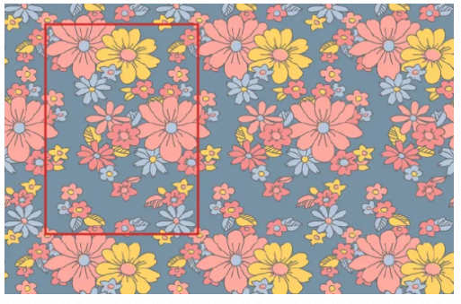
Like in fabric

Slide 7


Or even in legos..

Slide 8
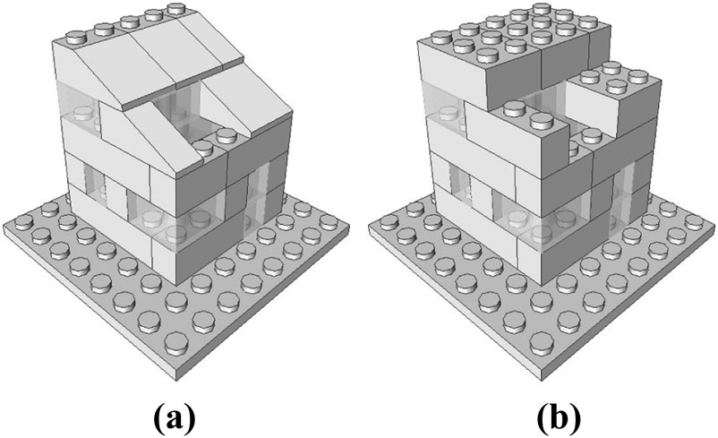
One builds using, using smaller building sets
Patterns!

Slide 9
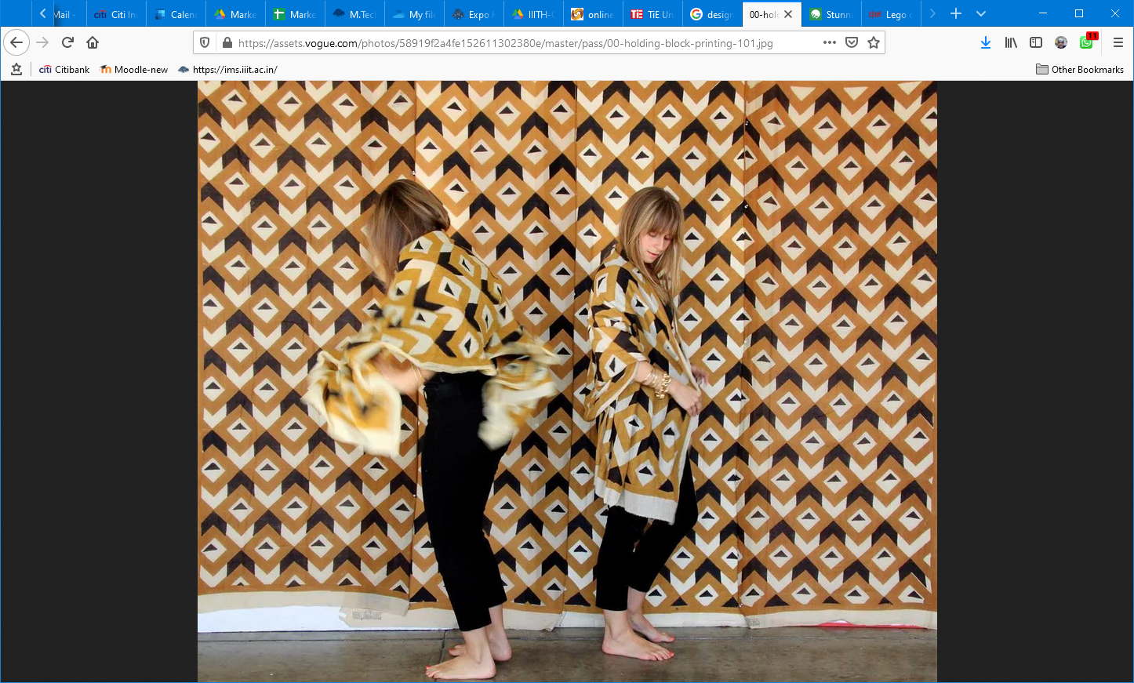
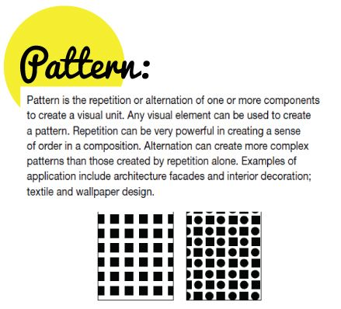

Slide 10

Tools for Patterns?

Slide 11

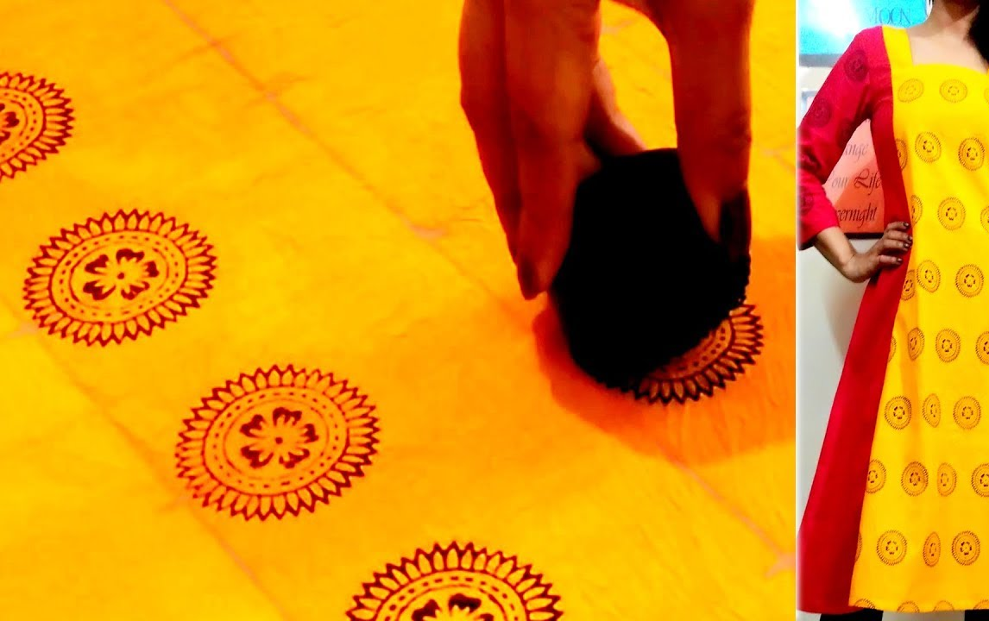
.. blocks

Slide 12
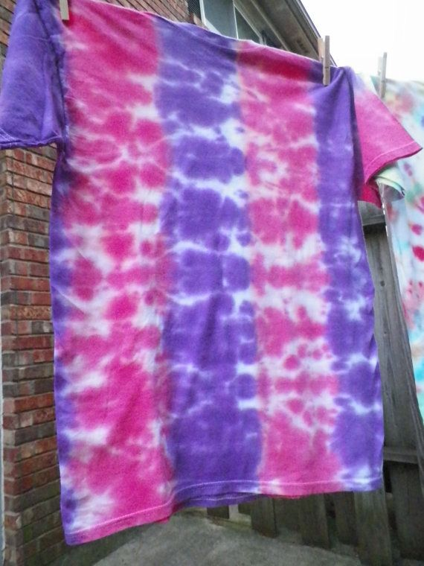

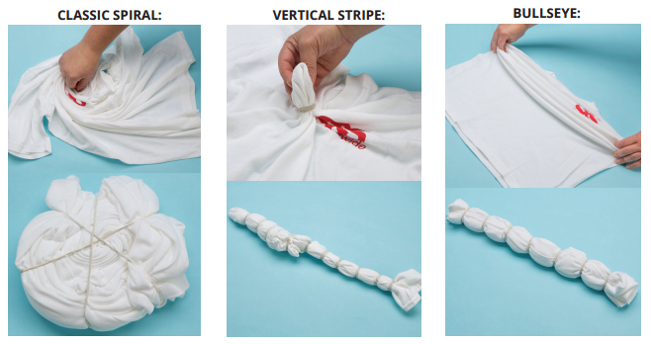

Or, “practices”

Slide 13
What does this mean for software?

Slide 14
When designing..
Each of us has encountered a design problem and silently thought: I wonder if anyone has developed a solution to for this?
Should we not make programming significantly more efficient by avoiding reinventing the “proverbial wheel”?
Instead of solving afresh, can we use methods defined and refined by others already?

Slide 15
Reuse others’ approaches?
What if there was a standard way of describing a problem (so you could look it up)?
And an organized method for representing the solution to the problem?

Slide 16
“Design patterns are used
to represent
some of the best practices
adapted by experienced
object-oriented software developers.
A design pattern
explains a general design
that addresses
a recurring design problem
in object-oriented systems”

Slide 17
Design Patterns
Each pattern describes a problem that occurs over and over again in our environment and then describes the core of the solution to that problem in such a way that you can use the solution a million times over without ever doing it the same way twice.
Christopher Alexander, 1977
“a three-part rule which expresses a relation between a certain context, a problem, and a solution.”
Design patterns are a codified method for describing problems and their solution allows the software engineering community to capture design knowledge in a way that enables it to be reused.

Slide 18
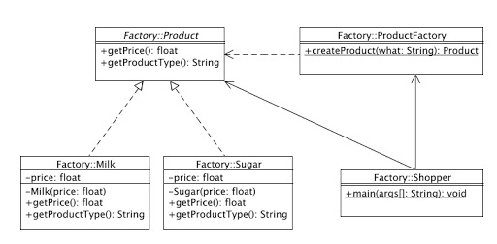
A Factory Pattern or Factory Method Pattern…
just define an interface or abstract class for creating an object..
but let the subclasses decide which class to instantiate.
In other words, subclasses are responsible to create the instance of the class.

Slide 19
Basic Concepts
Context allows the reader to understand the environment in which the problem resides and what solution might be appropriate within that environment.
A set of requirements, including limitations and constraints, acts as a system of forces that influences how
the problem can be interpreted within its context and
how the solution can be effectively applied.

Slide 20
Describing a Pattern
Pattern name—describes the essence of the pattern in a short but expressive name
Problem—describes the problem that the pattern addresses
Motivation—provides an example of the problem
Context—describes the environment in which the problem resides including application domain
Forces—lists the system of forces that affect the manner in which the problem must be solved; includes a discussion of limitation and constraints that must be considered
Solution—provides a detailed description of the solution proposed for the problem
Intent—describes the pattern and what it does
Collaborations—describes how other patterns contribute to the solution
Consequences—describes the potential trade-offs that must be considered when the pattern is implemented and the consequences of using the pattern
Implementation—identifies special issues that should be considered when implementing the pattern
Known uses—provides examples of actual uses of the design pattern in real applications
Related patterns—cross-references related design patterns

Slide 21
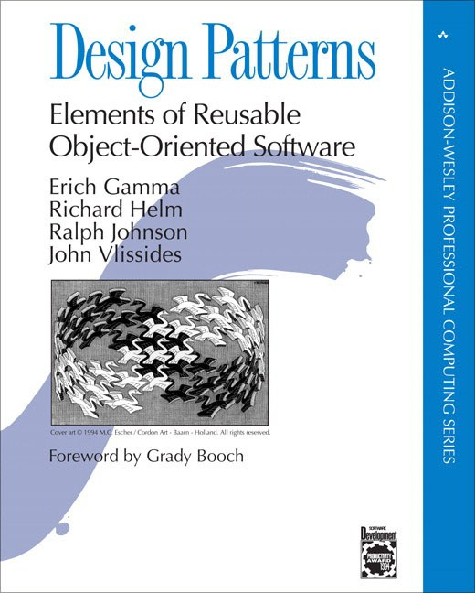
Design patterns (GOF)
The seminal book on design patterns
Design Patterns, Elements of Reusable Object-Oriented Software by Gamma et al,
“Design Patterns communicate solutions to common problems. It’s a problem-solution pair”

Slide 22
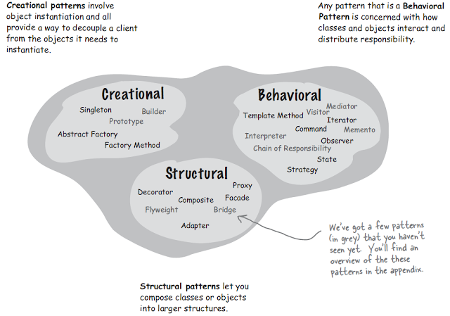
Types of patterns

Slide 23
Adapter Pattern
Adaptee
Adaptee Interface
translatedrequest()
Adapter
Target Interface
The Adapter implements the target interface and holds an instance of the Adaptee
client
request()
The client is implemented against the target interface

Slide 24
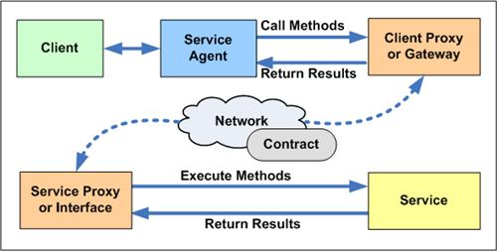
Proxy pattern
Proxy patterns provides a surrogate or placeholder for another object to control access to it
Remote proxy controls access to a remote object
Virtual proxy controls access to a resource that is expensive to create
Protection proxy controls access to a resource based on access rights

Slide 25
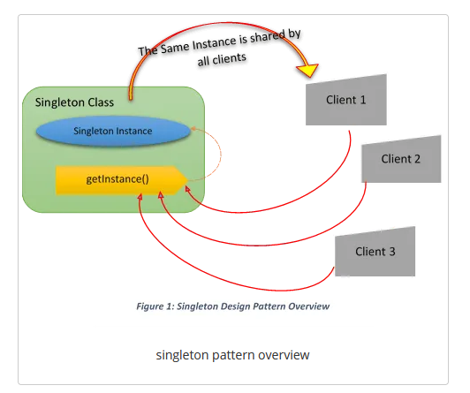
The Singleton Pattern
Context:
It is very common to find classes for which only one instance should exist (singleton)
Problem:
How do you ensure that it is never possible to create more than one instance of a singleton class?
Forces:
The use of a public constructor cannot guarantee that no more than one instance will be created.
The singleton instance must also be accessible to all classes that require it

Slide 26
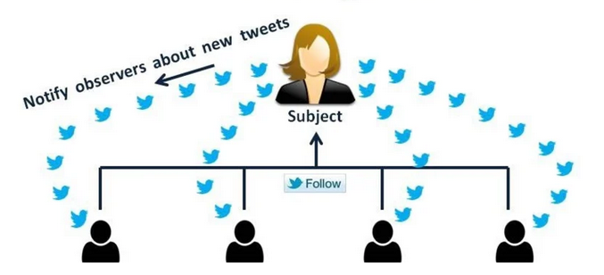
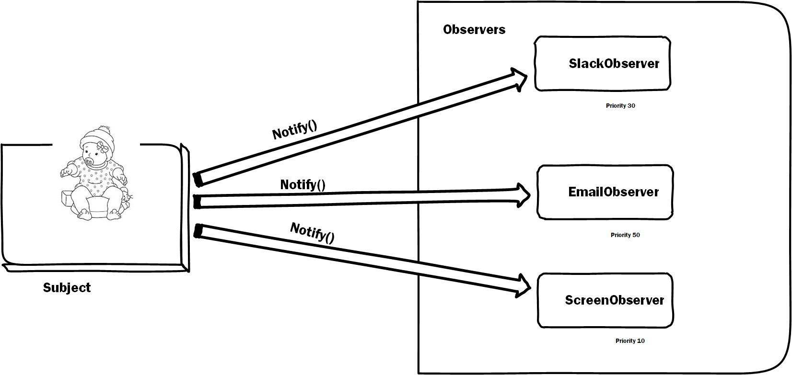
Observer pattern

Slide 27
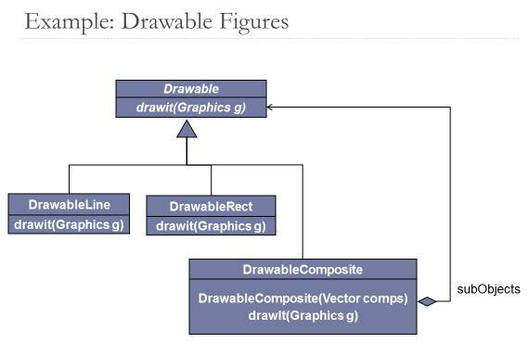
Composite Pattern: The Problem
File systems
Primitives = text files, binary files, device files, etc.
Composites = directories (w/subdirectories)
Make file dependencies
Primitives = leaf targets with no dependents
Composites = targets with dependents
Menus
Primitives = menu entries
Composites = menus (w/submenus)
Problem
Have simple primitive component classes that collect into larger composite components
Desire
Treat composites like primitives
Support composite sub-assemblies
Operations (usually) recurse to subassemblies
Solution
Build composites from primitive elements

Slide 28
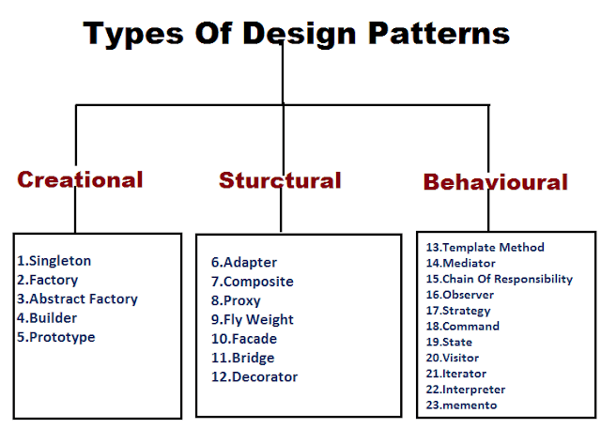
Creational patterns focus on the “creation, composition, and representation of objects, e.g.,
Singleton pattern: Control the creation of instances to just on3
Abstract factory pattern: centralize decision of what factory to instantiate
Factory method pattern: centralize creation of an object of a specific type choosing one of several implementations
Structural patterns focus on problems and solutions associated with how classes and objects are organized and integrated to build a larger structure, e.g.,
Adapter pattern: 'adapts' one interface for a class into one that a client expects
Aggregate pattern: a version of the Composite pattern with methods for aggregation of children
Behavioral patterns address problems associated with the assignment of responsibility between objects and the manner in which communication is effected between objects, e.g.,
Chain of responsibility pattern: Command objects are handled or passed on to other objects by logic-containing processing objects
Command pattern: Command objects encapsulate an action and its parameters
Observer pattern: Enable loose coupling between publishers and subscribers

Slide 29
DETAILS

Slide 30
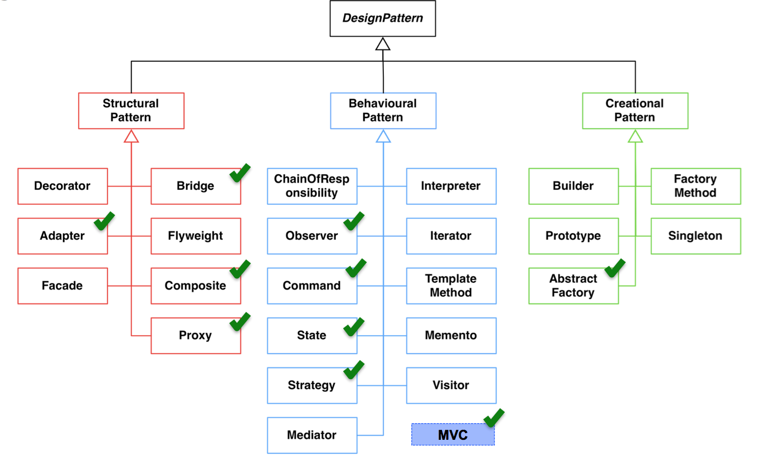

Slide 31
Adapter pattern
Acknowledgement: Head-first Design patterns. Freeman & Freeman

Slide 32
Example Scenario
The European wall outlet exposes one interface for getting power
The adapter converts one interface into another
The US laptop expects another interface

Slide 33
Adapter Pattern Explained
Adaptee
Adaptee Interface
translatedrequest()
Adapter
Target Interface
The Adapter implements the target interface and holds an instance of the Adaptee
client
request()
The client is implemented against the target interface

Slide 34
Adapter Pattern
An adapter pattern converts the interface of a class into an interface that a client expects
Adapters allow incompatible classes to work together
Adapters can extend the functionality of the adapted class
Commonly called “glue” or “wrapper”

Slide 35
When to Use
Need to adapt the interface of an existing class to satisfy client interface requirements
Adapting Legacy Software
Adapting 3rd Party Software

Slide 36
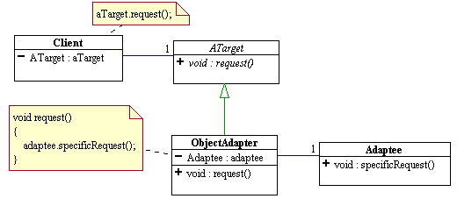
Object Adapter Pattern

Slide 37
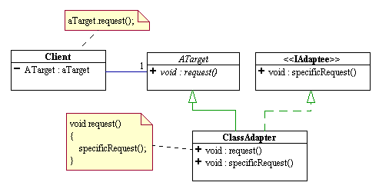
Class Adapter Pattern

Slide 38
When to Use Adapters
Concrete adapter When using a class whose interface does not match what you need.
Abstract adapter When creating a reusable class that cooperates with unknown future classes.

Slide 39
Proxy pattern
Acknowledgement: Freeman & Freeman

Slide 40
The Problems
Expensive & inexpensive pieces of state
Example: Large image
Inexpensive: size & location of drawing
Expensive: load & display
Remote objects (e.g., another system)
Want to access it as if it were local
Want to hide all the required communications
Example: Java RMI
Object with varying access rights
Some clients can access anything
Other clients have subset of functionality available

Slide 41
The Design Goal
In all these cases desire access to object as if it is directly available
For efficiency, simplicity, or security, put a proxy object in front of the real object
We have a stand-in for the real object to control how the real object behaves

Slide 42
Proxy pattern Defined
Proxy patterns provides a surrogate or placeholder for another object to control access to it
Remote proxy controls access to a remote object
Virtual proxy controls access to a resource that is expensive to create
Protection proxy controls access to a resource based on access rights

Slide 43
Proxy pattern structure
<<interface>>
Subject
request()
RealSubject
Proxy
request()
subject
request()

Slide 44
Example: Accessing Remote Object
Client
LocalProxy
RemoteObject
someMethod()
someMethod()

Slide 45
Java RMI, the big picture
Called
Caller
Caller
Called
Caller
Stub
Stub
Transport Layer (e.g. TCP or UDP)

Slide 46
Categories of Proxies
Remote proxy - as above
Local representative for something in a different address space
Java RMI tools help set these up automatically
Object brokers handle remote objects (CORBA or DCOM)
Virtual proxy
Stand-in for an object that is expensive to implement or completely access
Example – image over the net
May be able to access some state (e.g., geometry) at low cost
Defer other high costs until it must be incurred
Protection proxy
Control access to the "real" object
Different proxies provide different rights to different clients
For simple tasks, can do via multiple interfaces available to clients
For more dynamic checking, need a front-end such as a proxy

Slide 47
The Controller Façade Pattern
Context:
Often, an application contains several complex packages.
A programmer working with such packages has to manipulate many different classes
Problem:
How do you simplify the view that programmers have of a complex package?
Forces:
It is hard for a programmer to understand and use an entire subsystem
If several different application classes call methods of the complex package, then any modifications made to the package will necessitate a complete review of all these classes.

Slide 48
Façade
Solution:

Slide 49
Proxies/Adapters/Facades
Proxies and Adapters both place a stand-in object between the client and the real object
Adapters do so to change the real object's interface
Proxies do so to optimize access to the object via the same interface.
Facades ease the use of sub-systems of objects

Slide 50
The Singleton Pattern
Context:
It is very common to find classes for which only one instance should exist (singleton)
Problem:
How do you ensure that it is never possible to create more than one instance of a singleton class?
Forces:
The use of a public constructor cannot guarantee that no more than one instance will be created.
The singleton instance must also be accessible to all classes that require it

Slide 51
Singleton
Solution:
«Singleton»
theInstance
getInstance
Company
if (theCompany==null)
theCompany
theCompany= new Company();
Company «private»
getInstance
return theCompany;

Slide 52
Activity (Alternative designs)
You are developing software that provides a “sports ticker” service – users can bring up a score box for games they are interested in, and when the score for any game changes, the score box for all users who are interested in that game updates automatically.

Slide 53
Observer pattern
Acknowledgement: Freeman & Freeman

Slide 54
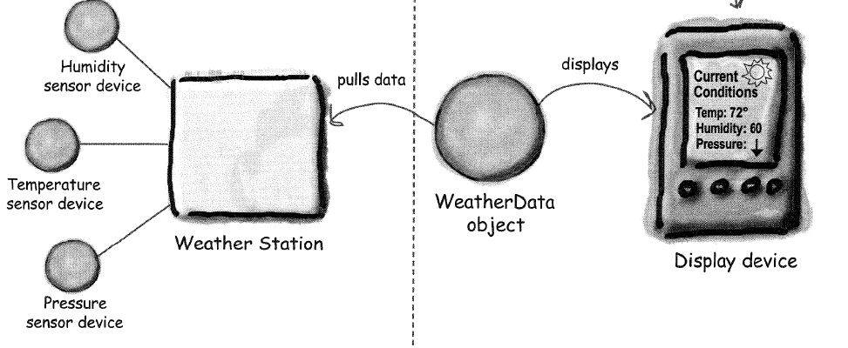
Weather Monitoring application
Display elements: Current conditions, Weather statistics, Simple forecast

Slide 55
WeatherData class
WeatherData
return most recent weather measurements
getTemperature()
getHumidity()
getPressure()
measurementsChanged()
// other methods
Gets called whenever the measurements have been updated

Slide 56
WeatherData Implementation
public class WeatherData {
// instance variable declarations
public void measurementsChanged() {
float temp = getTemperature();
float humidity = getHumidity();
float pressure = getPressure();
currentConditionsDisplay.update (temp, humidity, pressure);
statisticsDisplay.update (temp, humidity, pressure);
forecastDisplay.update (temp, humidity, pressure);
}
// other WeatherData methods here
}

Slide 57
The Problem
Given
Clusters of related classes
Tight connections within each cluster of classes
Loose state dependency between clusters
Desired
Keep each cluster state consistent when state changes in cluster it depends on
Provide isolation such that changed cluster has no knowledge of specifics of dependent clusters

Slide 58
Example: UI & Application
Application classes represent information being manipulated.
UI provides way to view and alter application state.
May have several views of state (charts, graphs, numeric tables).
Views may be added at any time.
How to tell views when application state has changed?

Slide 59
Approach One – Direct Connect
Application knows about each View object.
On state change, call appropriate method in the View object affected
Issues
Application needs to know which method to call in each View
Application aware of changes to UI (e.g., add/delete/change Views).

Slide 60
Approach Two : Observer Pattern
The observer pattern defines a one-to-many dependency between objects so that when one object changes state, all of its dependents are notified and updated automatically

Slide 61
Approach Two – Observer/Subject (AKA: publish/subscribe)
Observables: objects with interesting state changes
Observers: objects interested in state changes
Observers register interest with observable objects.
Observables notify all registered observers when state changes.

Slide 62
Observer Pattern - Class diagram
Observable
observers
Observer
attach(Observer)
detach(Observer)
notify()
*
*
update()
for ( o in observers ) {
o->update()
}
ConcObserver
myState
ConcObservable
subject
update()
getState()
myState = subject->getState

Slide 63
Interaction Diagram
: aConcObservable
: aConcObserver-1
: aConcObserver-2
setState()
notify()
update()
getState()
update()
getState()

Slide 64
When to Use Observer
Two subsystems evolve independently but must stay in synch.
State change in an object requires changes in an unknown number of other objects (broadcast)
Desire loose coupling between changeable object and those interested in the change.

Slide 65
Consequences
Subject/observer coupling (loose coupling)
Subject only knows it has a list of observers
The only thing the Subject knows about an Observer is that it implements a certain interface
Observers can be added at any time
Does not know any Observer concrete class
Subjects don’t need to be modified to add new types of Observers
Subjects and Observers can be reused independently
Supports broadcast communication
Observables know little about notify receivers
Changing observers is trivial
Unexpected & cascading updates
change/notify/update -> change/notify/update
May be hard to tell what changed

Slide 66
Designing the Weather Station
<<interface>>
Subject
<<interface>>
Observer
<<interface>>
DisplayElement
observers
registerObserver()
removeObserver()
notifyObservers()
update()
display()
WeatherData
CurrentConditionsDisplay
StatisticsDisplay
ForeCastDisplay
registerObserver()
removeObserver()
notifyObservers()
getTemperature()
getHumidity()
getPressure()
measurementsChanged()
update()
display() { // display current measurements}
update()
display() { // display the avg, min and max measurements }
update()
display() { // display the forecast }
subject
subject
subject

Slide 67
Observer Pattern – Key points
Observer pattern defines a one-to-many relationship between objects
Subjects/Observables update observers using a common interface
Observers are loosely coupled in that the Observable knows nothing about them, other than that they implement observer interface
You can PUSH or PULL data from the Observable when using the pattern (pull is considered more “correct”)
Don’t depend on specific order of notification for your observers

Slide 68
Composite pattern
Acknowledgement: Freeman & Freeman

Slide 69
The Problem
Problem
Have simple primitive component classes that collect into larger composite components
Desire
Treat composites like primitives
Support composite sub-assemblies
Operations (usually) recurse to subassemblies
Solution
Build composites from primitive elements

Slide 70
Examples - 1
File systems
Primitives = text files, binary files, device files, etc.
Composites = directories (w/subdirectories)
Make file dependencies
Primitives = leaf targets with no dependents
Composites = targets with dependents
Menus
Primitives = menu entries
Composites = menus (w/submenus)

Slide 71
Examples - 2
GUI Toolkits
Primitives = basic components (buttons, textareas, listboxes, etc).
Composites = frames, dialogs, panels.
Drawing Applications
Primitives = lines, strings, polygons, etc.
Composites = groupings treated as unit.
HTML/XML
Pages as composites of links (hypertext)
Pages as collections of paragraphs (with subparagraphs for lists, etc.)

Slide 72
Class Diagram (Alternative 1)
Component
generalOp()
add(Component c)
delete(Component c)
getChild(int i)
children
Leaf
Composite
generalOp()
generalOp()
add(Component c)
delete(Component c)
getChild(int i)
for all (c in children)
c.generalOp();

Slide 73
Class Diagram (Alternative 2)
Component
generalOp()
children
Leaf
Composite
generalOp()
generalOp()
add(Component c)
delete(Component c)
getChild(int i)
for all (c in children)
c.generalOp();

Slide 74
Example Object Structure
aComposite
aLeaf
aLeaf
aComposite
aLeaf
aLeaf
aLeaf
aLeaf

Slide 75
Example: Drawable Figures
Drawable
drawit(Graphics g)
DrawableLine
DrawableRect
drawit(Graphics g)
drawit(Graphics g)
DrawableComposite
DrawableComposite(Vector comps)
drawIt(Graphics g)
subObjects

Slide 76
Discussion
Clients (usually) ignore differences between primitives & composites
Clients access (most) components via the generic interfaces
Primitives implement request directly
Composites can handle directly or forward
Arbitrary composition to indefinite depth
Tree structure – no sharing of nodes
General digraph – supports sharing, multiple parents – be careful!
Eases addition of new components
Almost automatic

Slide 77
Evaluating Designs
The application of “well-known” design patterns that promote loosely coupled, highly cohesive designs.
Conversely, identify the existence of recurring negative solutions – AntiPatterns
AntiPattern : use of a pattern in an inappropriate context.
Refactoring : changing, migrating an existing solution (antipattern) to another by improving the structure of the solution.

